Slide 1

Sesi 15 I thought you were my friend and learning about part of speech
English team

Slide 2
LEARNING OBJECTIVES
Able to understand about concept vocabulary of speech
Able to understand about types of speech

Slide 3
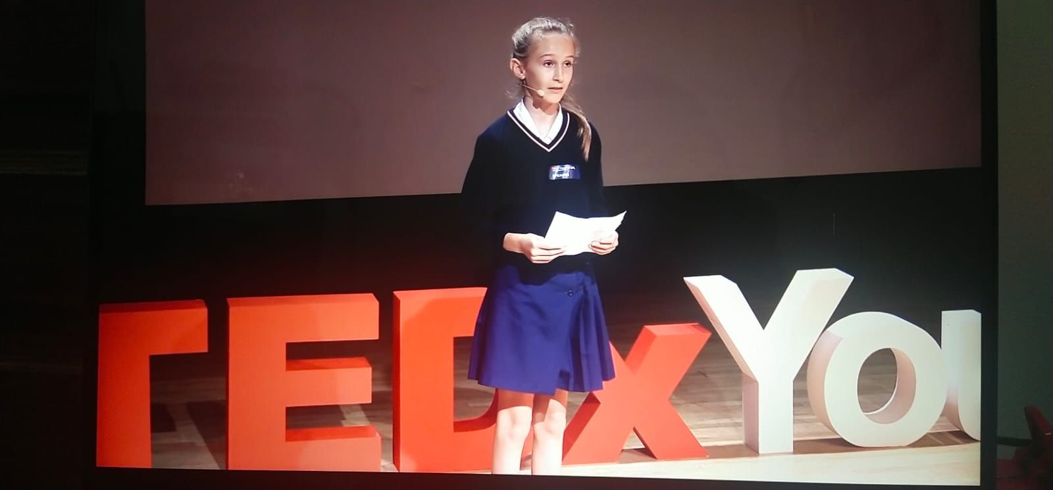
Speech : I thought you were my friend by Delphine Matta-Brown
https://www.youtube.com/watch?v=TU2PUkasdbM

Slide 4

What is a speech :
A text design to persuade a listener to agree with the speaker’s point of view
They are written in the first person
They begin with an anecdote or story
They use a variety of persuasive language technique

Slide 5
PART OF SPEECH | MEANING | EXAMPLE
NOUN | Name of a person, place, thing or idea | Daniel, London, table, hope
ADVERB | Modifies a verb, an adjective, or another adverb. It tells how (often), where, when | Slowly, very, always, well, too
PRONOUN | A pronoun is used in place of a noun or noun phrase to avoid repetition | I, you, it, we, us, the, those
ADJECTIVE | Describes, modifies or gives more information about a noun or pronoun | Cold, happy, young, two, fun
VERB | Shows an action or a state of being | go, speak, eat, live, are, is
PREPOSITION | Shows the relationship of a noun or pronoun to another word | At, on, in, from, with, about
CONJUNCTION | Joins two words, idea, phrases together and shows how they are connected | And, or, but, because, yet, so
INTERJECTION | A word or phrase that expresses a strong emotion. It is a short exclamation | Ouch! Hey! Oh! Watch out!

Slide 6
TYPES OF SPEECH
INFORMATIVE | PERSUASIVE | SPECIAL OCCASION
When writing an informative speech, you should focus on presenting facts or telling a story in a concise and engaging manner. | When writing a persuasive speech your job is to use facts and opinions to convince your audience to come around to your way of thinking. | Are meant to entertain or pay tribute to a person, place, or institution. These are the speeches we hear at weddings, funeral, parties, etc.

Slide 7
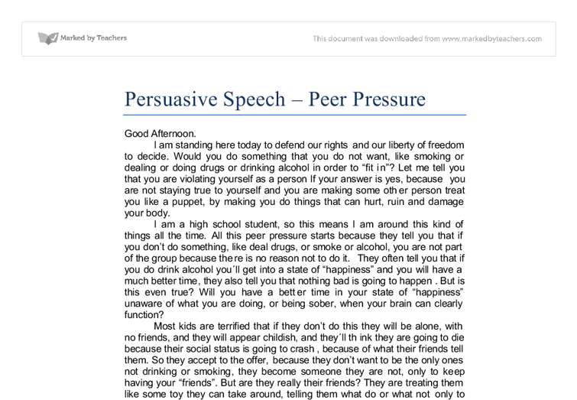

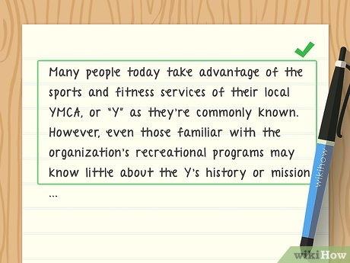
Example text of speech

Slide 8
The structure of a good speech
INTRODUCTION | BODY LINE | CONCLUSION
The opening of the speech | 3 – 4 main points about the main idea of the speech | The brief summary of the main points
The thesis statement of the speech | Sub – points within the main points that make your speech more detailed | The conclusion you arrive at
The ‘attention – grabber ‘ in the speech | Visuals aid to keep the speech interesting | Call to action

Slide 9
Conclusion
The final part of your speech gives you an opportunity to state your main ideas again, briefly.
This is a good time to tell you audience exactly what you want them to do or believe about your subject.
Do this by summarizing your main points, restating the purpose of the speech, telling a story to summarize your speech, using a quotation that aptly expresses the point, or telling the audience exactly what they should do
This is your last chance to impress the audience. Plan your conclusion so that you can finish forcefully.

Slide 10
Now, let’s practice for your extra score !
Recording of your speech (duration 5 minutes enough)
You can use any speech do you like
Send your recording to email

Slide 11

Bye…. Bye….. See you again everyone!

